Slide 1

A Multi-factor Security Protocol for
Wireless Payment-Secure Web
Authentication using Mobile Devices
Under the Esteemed Guidance of
Dr. K V D KIRAN

Slide 2

Presented by, (Batch Number – 281) 170030193 - CHALLA VENKATA PRANITH 170030614 - KOLLI SAI KIRAN 170031068 - PULIVARTHI GOUTHAM 170031340 - VALIVETI LOHYA SUJITH

Slide 3
Abstract
The Cell phones have revolutionized the way we live. Cellular phones and PDA's have largely grown in popularity and as a result users have started online banking, purchasing of internet-based products and other online services. Previous web access authentication systems have used either the Internet or the wireless Mobile channel independently to authenticate the identity of remote user.
Accessing today's web-based services always requires a username and password to authenticate the user identity. This is a significant vulnerability since the password can be hacked by the man in the middle attack and later used for making illegal access to the user’s account. Our goal is to create an authentication system that is both secure and highly usable based on multifactor authentication approach. It uses a novel approach to create an authentication system based on TICs (Transaction Identification code) and SMS (Short Message Service) to enforce an extra security level with the traditional Login/password system.
We have also used an encryption/decryption technique which is based on symmetric key and an iterated block cipher concept. This concept has been used to keep TICs as secret code on cell phones/PDAs and is also used to initiate secure web transaction using cell phones/PDAs. Finally we extend the system for two way authentication which authenticates both parties (user and e- service provider). A detailed threat analysis demonstrates that the proposed system is secure against various types of internet attacks like phishing, man-in-the-middle, viruses etc.

Slide 4
Objective
The main objective of the present work is to provide a highly secure wireless environment for financial web transactions that is simple to use and deploy, that does not require any change in existing wireless networks or protocol.
This Protocol for Wireless Payment is used to achieve secure web transaction using cell phones / PDAs. The system is based on Multi-factor Authentication concept to provide secure wireless environment to the users to increase faith of the users in online financial web transactions using mobile devices

Slide 5
Introduction
As computing becomes pervasive, people increasingly rely their business over the Internet by using
e-commerce. Now, the Internet is a preferred source to access online eservices such as e-commerce,
e-voting, e-banking, e-government, etc.
Online applications require a strong security feature to protect user confidential data. Security is a major
issue in internet based online payment system. There are various internet threats which affect the
security system of internet and increase risk for electronic transaction. Most of the authentication system
relies on passwords, personal identification numbers and keys to access their personal account information
This type of authentication system can not verify or authenticate the identity of the users who he or she claims
to be Accessing today's web-based services always requires a username and password to authenticate the user
identity. This is a significant vulnerability since the password can be hacked by the man in the middle attack
and later used for making illegal access to the user’s account.

Slide 6
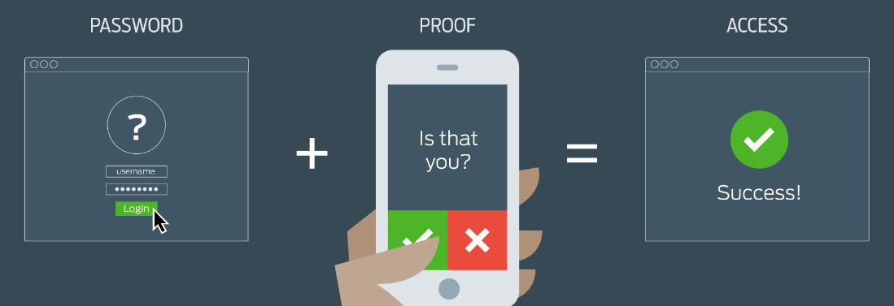
When it comes to the communication of sensitive data security has always been an important topic. With hardware advances allowing users the advantage of accessibility used in mobile devices, individuals are now spending more and more time on these devices. Additionally, with the viral popularity of social media applications and single sign-on, users do not always take as many precautions as needed with their information. Multi-factor authentication creates more and varied walls to block out the wrong people from seeing your information

Slide 7
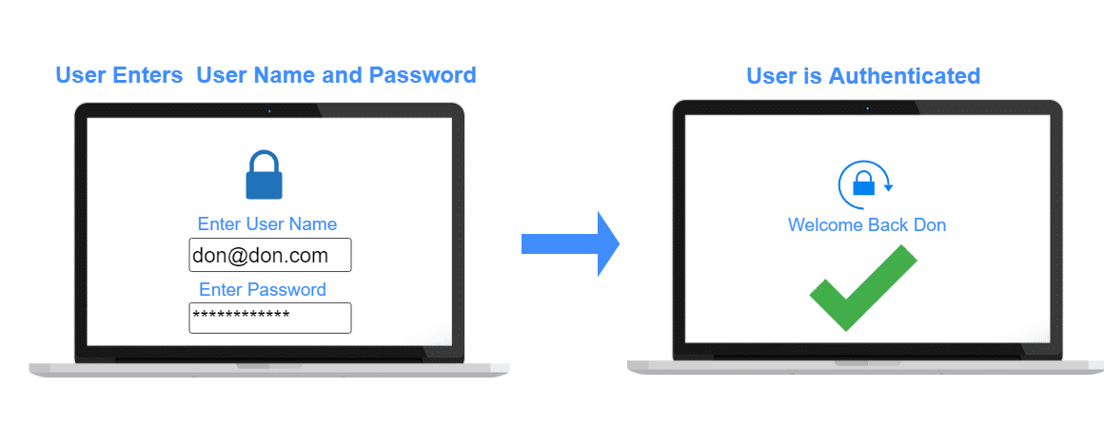
What is Single-factor Authentication (SFA):
Single-factor authentication is the simplest form of authentication methods. With SFA, a person
matches one credential to verify himself or herself online. The most popular example of this would be
a password (credential) to a username. Most verification today uses this type of authentication
method.

Slide 8
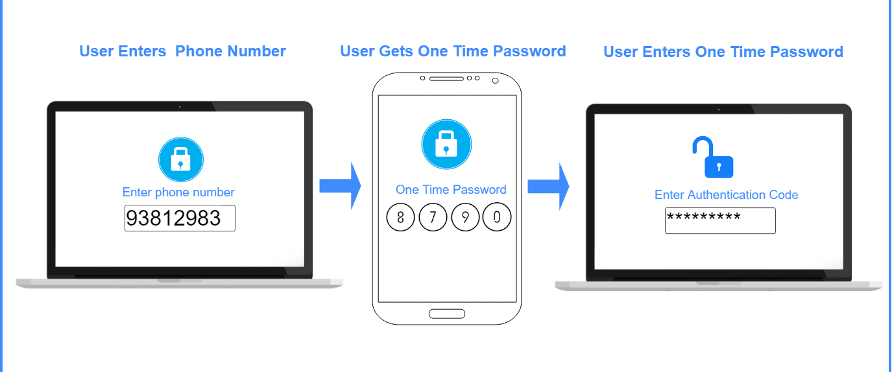
What is Two-factor Authentication (2FA):
Two-factor authentication uses the same password/username combination, but with the addition of being
asked to verify who a person is by using something only he or she owns, such as a mobile device. Putting it
simply: it uses two factors to confirm an identity

Slide 9
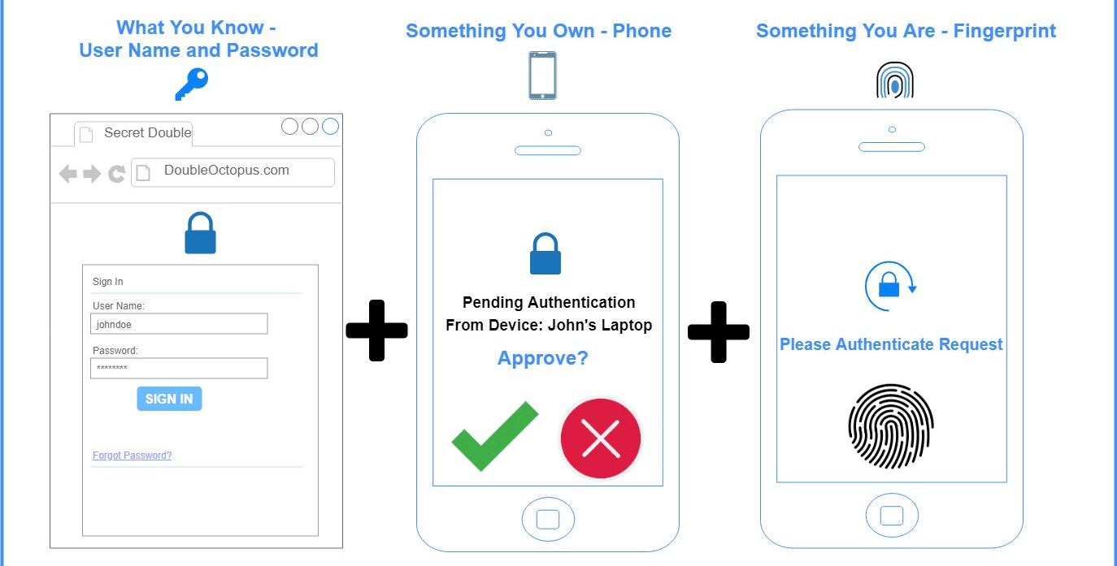
What is Multi-factor Authentication (MFA):
Multi-factor Authentication uses a combination of the following factors: something you know,
something you have and something you are. 2FA is a subset of MFA

Slide 10
Division of Modules
Module 1
Module 2
Module 3
Module 4
Introduction to Factors of Authentication and Existing System.
Specification , Transaction flow of the Protocol & Cryptography
System analysis with various Internet threats & Technology .
System implementation & simulation results

Slide 11
Literature Survey
In recent years, the development in Information technology has unleashed new challenges and
opportunities for new authentication systems and protocols. Authentication ensures that a user is who
they claim to be. The trust of authenticity increases exponentially when more factors are involved in the
verification process. When security infrastructure makes use of two or more distinct and different
category of authentication mechanisms to increase the protection for valid authentication, It is referred
to as Strong Authentication or Multifactor Authentication. Multifactor authentication uses combinations of
"Something you know," "Something you have,", "Something you are" and “Somewhere you are”,
“Someone you know”, to provide stronger remote authentication than traditional, unreliable single-factor
username and password authentication. In this paper we are doing a survey on the different aspects of
multifactor authentication, its need, its techniques and its impact. Multi-factor authentication methods are
difficult to compromise than single-factor methods.
for example, the use of a logon ID/password is single-factor authentication (i.e., something the user knows)
whereas, an ATM transaction requires multifactor authentication: something the user possesses (i.e., the
card) combined with something the user knows (i.e., PIN). “Out-of-band” controls for risk mitigation can
also be included in multifactor authentication methodology

Slide 12
Online Banking Fraud:
Internet Banking Fraud is a fraud or theft committed using online technology to illegally remove money
from a bank account and/or transfer money to an account in a different bank. Online bank fraud is one of
the most widespread forms of cybercrime.
There are mainly 2 Types of Online Frauds:
User Identity Theft:
Identity theft is the deliberate use of someone else's identity, usually as a method to gain a financial
advantage or obtain credit and other benefits in the other person's name, and perhaps to the other
person's disadvantage or loss.
User Session Hijacking:
Session hijacking occurs when a session token is sent to a client browser from the Web server following
the successful authentication of a client logon. A session hijacking attack works when it compromises the
token by either confiscating or guessing what an authentic token session will be, thus acquiring
unauthorized access to the Web server

Slide 13
The flow of implementation will be as follows, The merchant will first register a source of funds and a
payer device with a unique ID with the payment server. Then once a merchant and the payer have
agreed on a financial transaction amount, the merchant requests a transaction ID from the payment server
for that amount. The payment server sends the merchant a transaction ID, which the merchant then
communicates to the payer. The payer in turn relays this transaction ID to the server, which validates the
transaction using the payer device. The server then releases funds to the merchant. The server can
preserve all records for auditing purposes, but security is enhanced because the merchant never gets
direct access to the customer's financial account information
Therefore we consider 4 phases in the transaction flow of the system as follows,
1. Firstly, the basic login i.e validating the credentials of user/payer
2. Performing of Two factor authentication
3. Now validating of the Transaction Identification Code (TIC).
4. SMS Confirmation.

Slide 14
At the start of user session the server randomly generates one secret key (128 bits) and stores it
individually for each user. The server use 128 bit shared secret logic to encrypt this secret key,
which is a shared secret and known to both ends i.e., client and server. This encrypted secret key is
transmitted to the client. The client decrypts this secret key and uses it in the later stages of the
transaction to encrypt the required account details of the customer with TIC code before
transmission to the server. On server side same secret key is stored which decrypts the
transaction details and TIC code, then matches the TIC code with the issued TICs to the
customer. If this TIC matches with the database then it will next process the transaction
otherwise transaction would be denied.
Encryption algorithm plays very important role in communication security, On a survey the
Based on the text files used and the experimental result it was concluded that AES algorithm
consumes least encryption and RSA consume longest encryption time . From the simulation
result, we evaluated that AES algorithm is much better than DES and RSA algorithm.

Slide 15
Phishing is a cybercrime in which a target or targets are contacted by email, telephone or text message by
someone posing as a legitimate institution to lure individuals into providing sensitive data such as
personally identifiable information, banking and credit card details, and passwords.
User Session Hijacking:
Session Hijacking is an attack which is basically used to gain the unauthorized access between an
authorized session connections. This is usually done to attack the social network website and banking
websites in order to gain the access over the valid session as well as over the website too.
Virus Attack on Cell Phones & PDAs: Most current cell phones have the ability to send and receive text
messages. Some cell phones and PDAs also offer the ability to connect to the Internet. Although these are
features that you might find useful and convenient, attackers may try to take advantage of them.
abuse your service.
lure you to a malicious web site.
use your cell phone or PDA in an attack.
gain access to account information.

Slide 16
Prevention:
Apply available critical patches and upgrades to the operating system
Eliminate or disable unnecessary services and applications
Install and configure additional applications that are needed
Configure user authentication and access controls
Technologies:
J2ME Toolkit Features:
Support for obfuscation in the build cycle.
Method profiling.
JDK Security Features types:
Users running programs.
Systems administrators, developers, and users.
JDBC (The Java Database Connectivity ):
JDBC specification is a new basis for developers to interface with data sources.
ORACLE 9i with J Server:
Oracle9i Application Server provides the lowest total cost of ownership of any application server on
the market, by delivering the most comprehensive, standards- based functionality from a single fully
integrated e-Business platform.

Slide 17
Authentication of the user to the Bank authentication Server based on user login/password:
authentication has three tasks:
Manage the connection between the human (user) and the website’s server (computer).
Verify users’ identities.
Approve (or decline) the authentication so the system can move to authorizing the user.
Password-Based User Authentication Methods:
When you land on the page, you’ll be asked to enter your username and password.
Your credentials are sent to the website’s server and compared with the information they have on file.
When a match is found, you’ll be able to enter your account.
TIC authentication:
TIC Authentication is the technique which is used to identify both the user and the ongoing transaction.

Slide 18
SMS authentication:
Another method to validate user transaction is an SMS confirmation. Financial institution stores user cell phone number to provide multifactor authentication. It is believed that users will carry cell phone and can receive/send the short message.
According to the Mobile Payment Forum, mobile payments are the transactions with a
monetary value that is conducted through a mobile telecommunications network through
diverse mobile users' devices, such as cellular telephones, smart phones or PDAs, and mobile
terminals. Mobile payment is a transfer of funds in return for goods or services in which a
mobile device is functionally involved in executing and confirming payment. The payer can
be standing at a POS or be interacting with a merchant located somewhere else. Mobile
payment systems enable customers to purchase and pay for goods or services via mobile
phones. Here, each mobile phone is used as the personal payment tool in connection with
the remote sales. Payments can take place far away from both the recipient and the bank

Slide 19
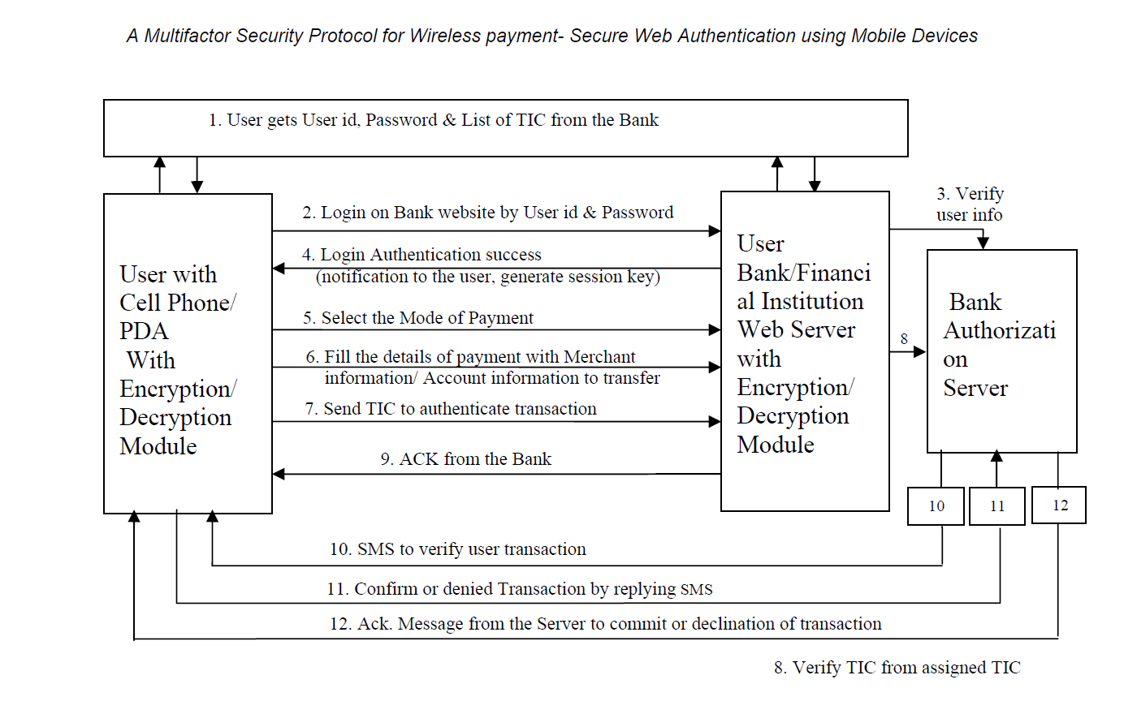
Proposed Protocol

Slide 20
Proposed Protocol 1. The first authentication of the user by the bank authentication server i.e. the basic login and password based user authentication. 2. Two way authentication i.e. authentication of the merchant / vendor / service provider. 3. The second authentication of the user and the transaction using TIC. 4. The final authentication and confirmation of transaction by the user, using SMS

Slide 21
TIC Generation Algorithm In the proposed protocol TIC codes are the most sensitive data which are stored on cell phone/ PDA. To maintain the security we have proposed that TICs are stored on the cell phone/PDA in an encrypted format and password protected The user will insert the local password of TICs to open the encrypted list of TICs & select any TIC from the list to initiate financial transaction import random tic=[] tic_length = 8 possible_characters = "abcdefghijklmnopqrstuvwxyz1234567890ABCDEFGHIJKLMNOPQRSTUVWXYZ" for i in range(8): tic_character_list = [random.choice(possible_characters) for i in range(tic_length)] tic.append("".join(tic_character_list)) print("The following are tic codes..") print() for indiv_tic in tic: print(indiv_tic)

Slide 22
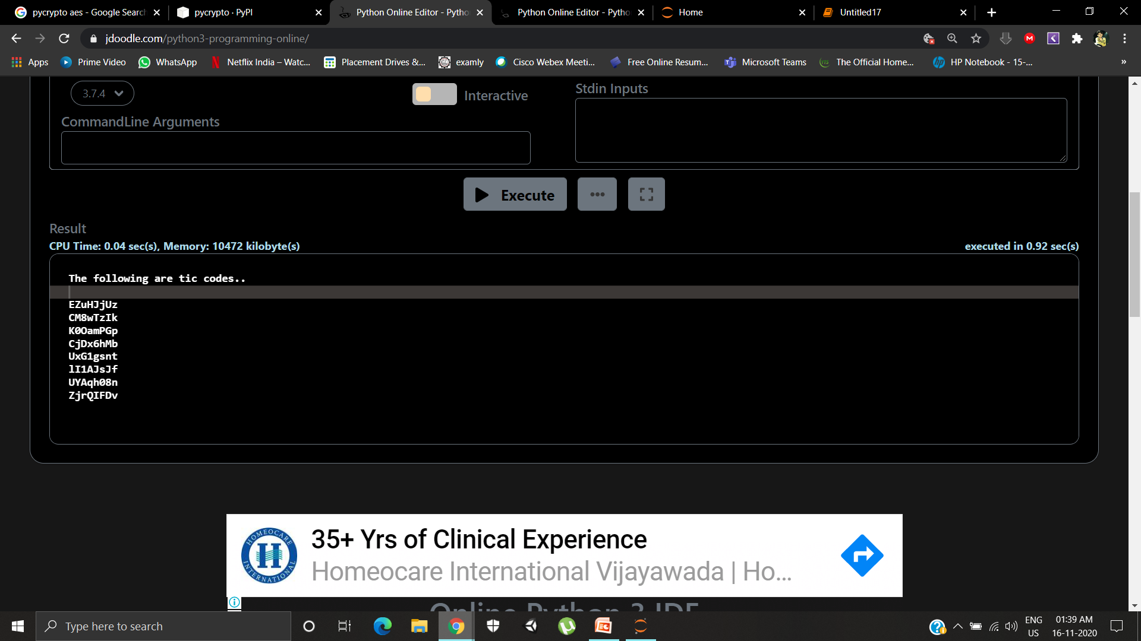
These are the sample unique Transaction Identification codes (TIC codes) generated at the user end at initial stages of the payment

Slide 23
The Pseudo Code for the key Expansion is as follows KeyExpansion (byte key[16], word w[4] ) { word temp; for (i=0; i<4; i++) a[i] = (key[4*i], key[4*i+1], key[4*i+2], key[4*i+3]); for(i=4; i<44; i++) { temp=w[i-1]; if ( i mod 4 = = 0) temp = SubWord ( RotWord (temp)) XOR Rcon[i/4]; w[i] = w[i-4] XOR temp; } } Initial four words of the expanded key are the replica of key. The remaining part of the expanded key is populated with four words at a time. Each new words, w[i], depends on the w[i-1] which is the just previous word of w[i] and the word four positions back, w[i-4]. A simple XOR is used in three cases out of four.

Slide 24
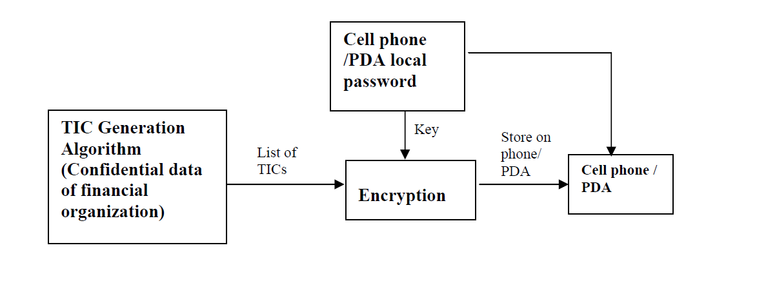
The local Encryption and decryption of TIC is also based on the AES symmetric key algorithm. AES cryptographic algorithm is best suited for the small devices, it enhanced the performance of cryptographic processing speed over small hand held devices instead of degrading the device performance

Slide 25
Conclusion
The current authentication technique for online payment system is not very secure to protect
user from identity theft, as a the result any attacker gain the access on confidential
information of user like credit card number or account password and make illegal transfer of
fund which will be charged to the valid user’s account
In the presented protocol we have focused on an application-layer security solution for
wireless payment system to implement an end-to-end authentication and data
confidentiality between wireless client and java based secure server. The presented work
proposed a new protocol for web user authentication based on multifactor authentication
approach which is completely secure and easy to implement

Slide 26
Future Work
Future work will focus on developing a new and efficient way for TIC codes generation
at the financial institutions. TIC code installation on the user’s cell phone must also be an
easy task to avoid repeated visits by the customers to the bank or financial institution.
Server side TIC maintenance, management mechanism and distribution to satisfy the
demand from a large number of users are also part of future work.

Slide 27
References
https://www.cmu.edu/iso/news/mfa-article.html#:~:text=Multi%2Dfactor%20authentication%20should%20be,protect%20highly%20sensitive%20personal%20information
https://ieeexplore.ieee.org/document/8701960
https://ieeexplore.ieee.org/document/8356384
https://ieeexplore.ieee.org/document/5069395
https://ieeexplore.ieee.org/stamp/stamp.jsp?tp=&arnumber=8701353
https://patentimages.storage.googleapis.com/72/48/2b/771c690320fa7b/US20050143051A1.pdf
https://www.tifr.res.in/~sanyal/papers/Multifactor%20Secure%20Authentication.pdf

Slide 28
https://computerresearch.org/index.php/computer/article/view/272/272
https://patentimages.storage.googleapis.com/a3/05/ed/e476c9ce65dc6e/US20130124364A1.pdf
https://ieeexplore.ieee.org/document/8356383
https://ieeexplore.ieee.org/abstract/document/8255200
Adi W., Mabrouk A., Al-Qayedi A., Zahro A. , “Combined Web/Mobile
Authentication for Secure Web Access Control”, In Wireless communications and
Networking conference, IEEE Communications Society, Atlanta, GA USA,
volume 2, pp. 677- 681, March 2004.

Slide 29
Thank You! -Batch No-281

